Slide 1





Development of a controlled vocabulary for learning objects’ functional description in an educational repository
International Conference on Dublin Core and Metadata Applications, 3 - 6 October 2006
Miguel Ángel Marzal
Javier Calzada-Prado
Mª Jesús Colmenero Ruiz
Aurora Cuevas Cerveró
DOTEINE Research Group (ACROPOLIS)
http://doteine.uc3m.es
Library & Information Science Department
University Carlos III of Madrid

Slide 2
Outline
Current and envisioned scenario
The DOTEINE project
The MIMETA AP
Learning objects’ functional structure
Type and function vocabulary
Conclusions and future work

Slide 3
Current and envisioned scenario:
Towards CRA (LRC) & CRAI (LRRC)
Current scenario
  Transforming the Information Society into the Knowledge Society depends highly on Education
  Current educational policies focus on the need for:
    Applying ICT
    Optimizing educational resources
    Learner-centered oriented education
    Resource-based, autonomous learning
Envisioned scenario
  Digital libraries providing real and virtual spaces to learn individually and collaboratively as well as to share and produce learning materials

Slide 4
Highlight
There’s a need for developing documentary tools in educational digital libraries that enable sharing, retrieving and reusing contents as a way to optimize teaching practice and educational resources

Slide 5
The DOTEINE project
Funded, started in 2003
Main goal: to develop instruments for document organization and retrieval that can be used to support learning from educational digital libraries
Project constraints:
  Educational domains covered:
    Primary and Secondary Education: Biology / Language & Literature
    Undergraduate and Postgraduate levels: Law / Content Analysis
  Language:
    Spanish

Slide 6
The MIMETA Application Profile
Goal: To set a description model for Spanish educational content
Predominant standards in the educational metadata domain: IEEE Learning Object Metadata (LOM) [too many elements] and DC [not many educational elements]
Intend to combine simplicity and semantic richness/representativity
ISO/IEC JTC1/SC36 draft standard
The MIMETA application profile comprises:
    General description elements
    Educational description elements

Slide 7
The MIMETA AP
General Description
Element | Description | Type
<identifier> | Code number | Mandatory, non-repeatable
<author> | Author/s | Mandatory, repeatable
<author_type> | Type of authorship | Optional, repeatable
<institution> | Institutional authorship | Optional, repeatable
<title> | Title of the resource | Mandatory, non-repeatable
<date> | Publication or release date | Mandatory, non-repeatable
<language> | Language/s of the resource | Mandatory, repeatable
<description> | Description of the resource | Mandatory, non-repeatable
<format> | Format of the resource | Mandatory, repeatable
<type> | Resource type | Mandatory, repeatable
<rights> | Property rights involved | Mandatory, non-repeatable
<subject> | Subject matter, controlled | Mandatory, repeatable
<keywords> | Keywords, uncontrolled | Mandatory, repeatable
<relation> | Relation considered: “Is part of” | Optional, repeatable

Slide 8
The MIMETA AP
Setting educational elements
Analysis of relevant EDL projects
  Lack of Spanish projects at that time (now: Educamadrid, Universia)
  ARIADNE, EdNA Online, EduSource, The Gateway to Educational Materials GEM, MERLOT and The Learning Federation SOCCI
  Five categories of educational elements (As Sutton & Mason 2001):
      Ideal target user for the resource
      Educational context or level in which the resource can be used
      Pedagogical characteristics of the resource
      Type of resource
      Amount of time the user requires to use or to accomplish the educational goals associated with the resource

Slide 9
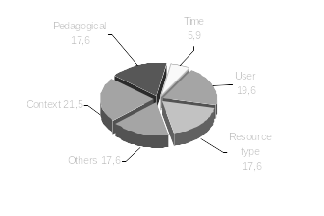
The MIMETA AP
Categories
Pedagogical and Context categories received most local extensions

Slide 10
The MIMETA AP
Educational Description
Element | Description | Type
<user_type> | Kind of potential user | Mandatory, repeatable
<context> | Educational context/level | Mandatory, repeatable
<difficulty> | Degree of difficulty | Mandatory, non-repeatable
<prerrequisites> | Previous knowledge required | Optional, repeatable
<interactivity_type> | Kind of interaction of the resource | Mandatory, non-repeatable
<pedagogical> | Pedagogical methods and goals | Optional, repeatable

Slide 11
Development of the repository
Carried out by the CRISOL (Centro de Recursos de Información y Software Libres), Computing Services, Carlos III University
Hosted in the DOTEINE project server (http://doteine.uc3m.es/doteine)
MIMETA elements as fields of the SQL database
JavaServer Pages user interface
Functionalities:
  Restricted access
  Adding and browsing document descriptions
  Field searching
  Uploading files
Still in test

Slide 12
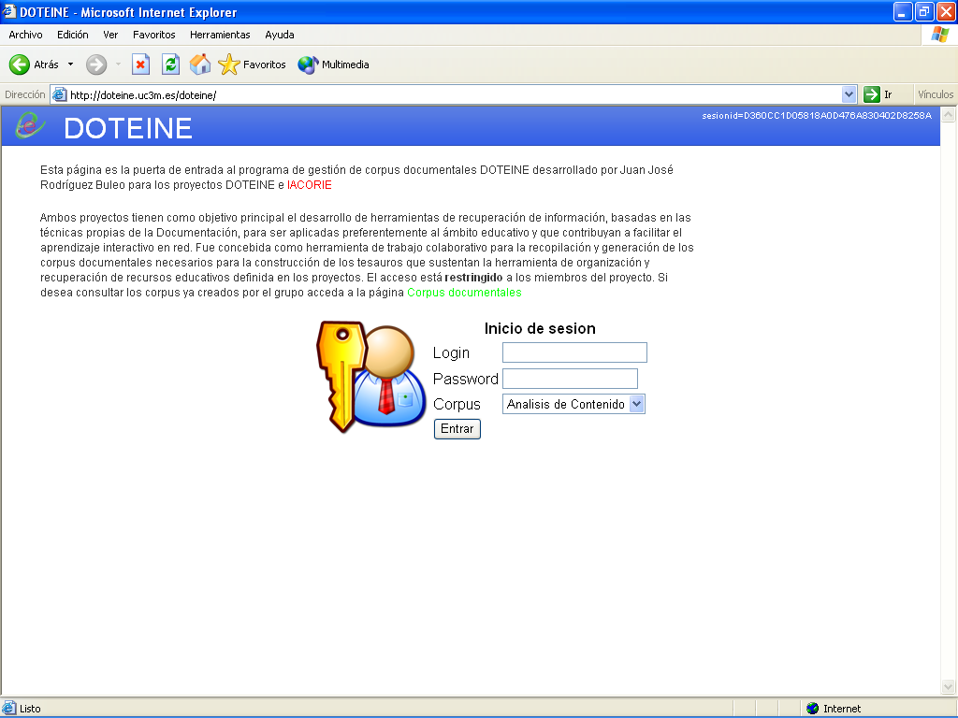
Restricted access
Access by domain

Slide 13
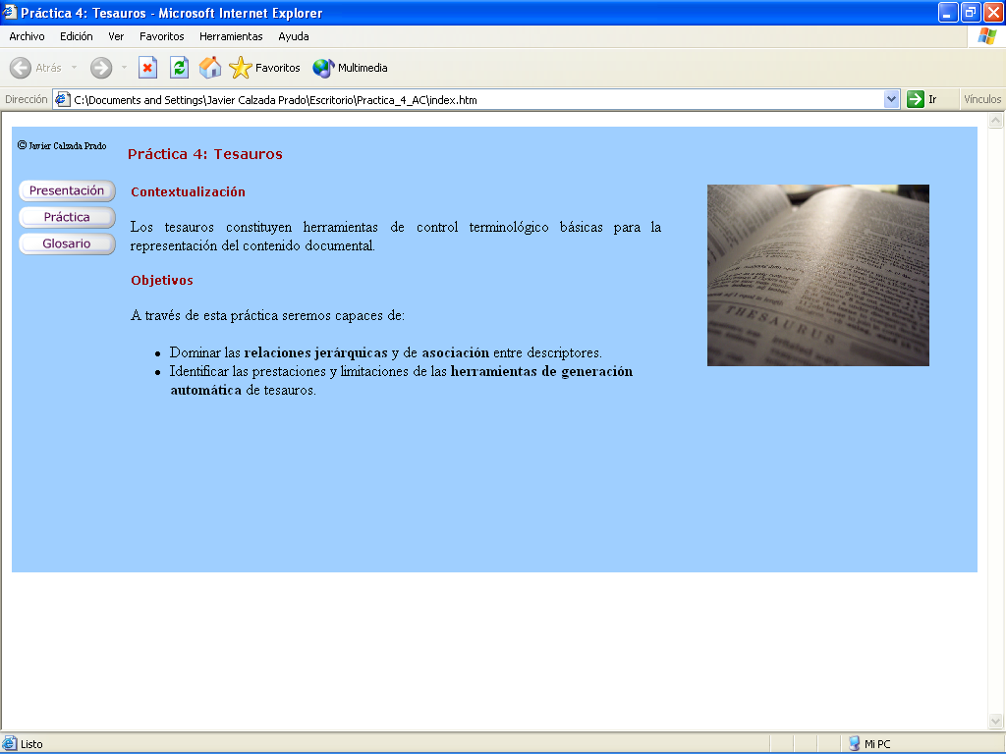
The repository at work
Incorporating learning objects to the repository:

Slide 14
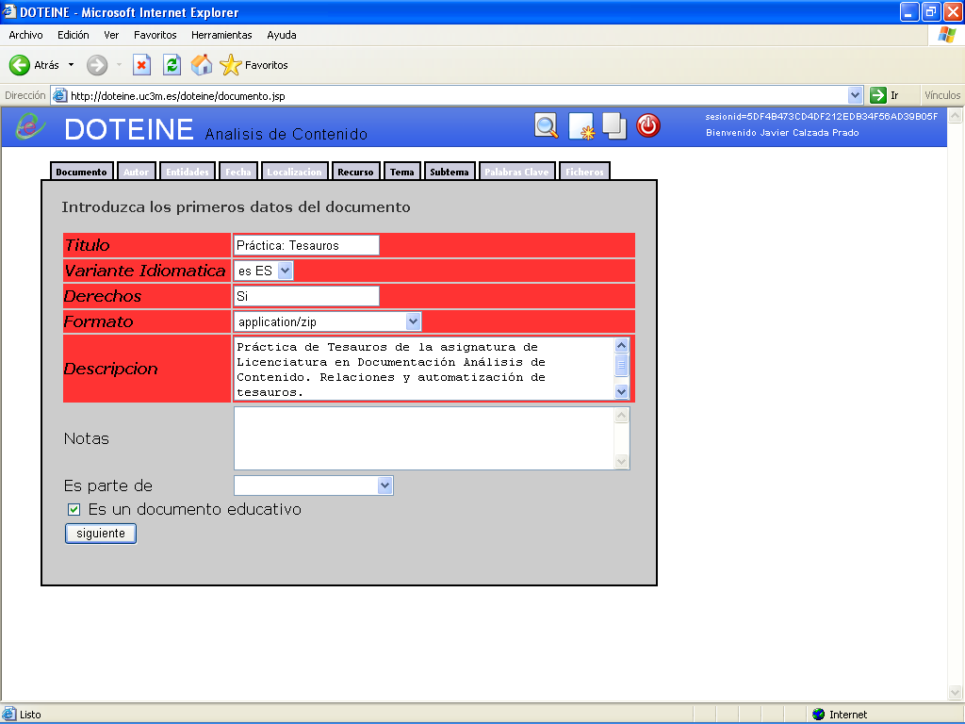
Add
new record
Cataloging the LO:
new record form

Slide 15
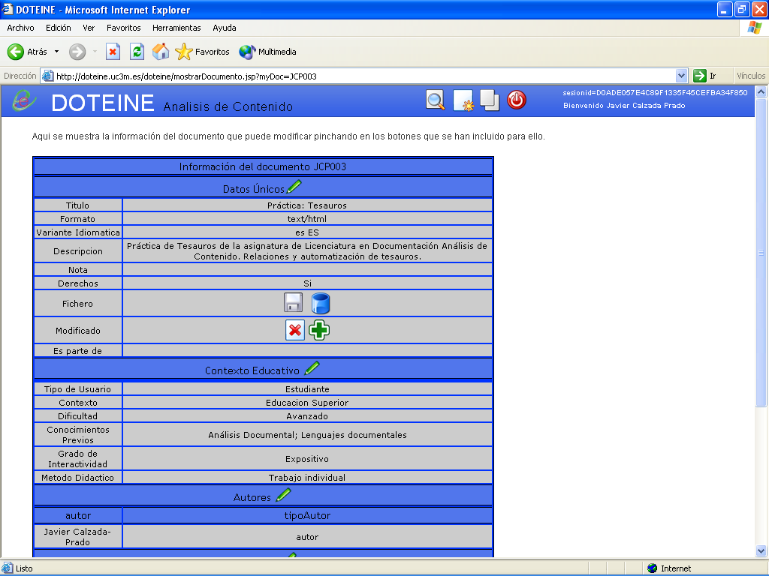
Cataloging the LO: Record display

Slide 16
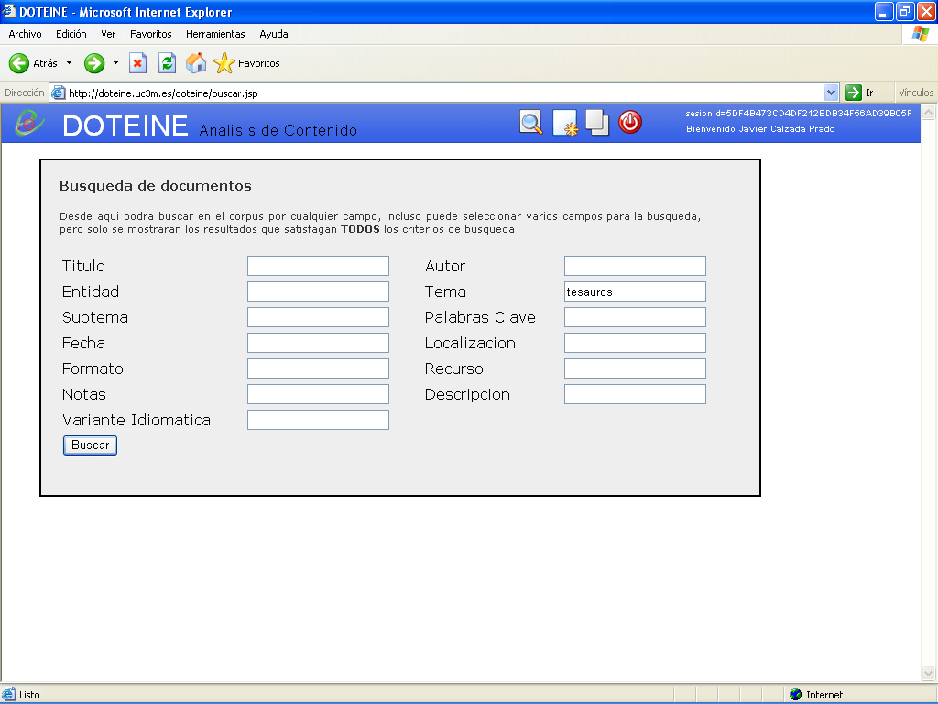
Search by subject

Slide 17
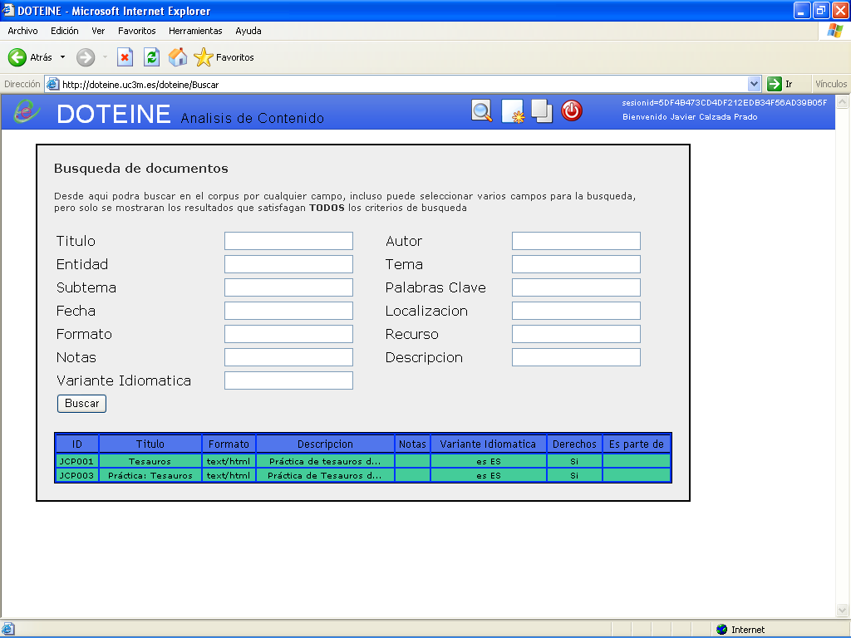
Retrieved documents

Slide 18
Informative vs. educational documents
What is a learning object (for us)?
Conceptual framework: Educational Information Communication Process
Sender – Educational message - Recipient
Motivation defines semantic superstructures (SS)
(→ document typology)
Educational motivation: make someone learn something or how to do something
Efficient educational SS:
Presentation – Exposition - Illustration - Assessment
Learning objects: digital, modular, described documents
Different from informative documents (which may eventually aquire an educational value)

Slide 19
The type and function vocabulary (TFV)
Supports teacher’s learning object reuse
Supplementary to content matter retrieval (→ specifically developed vocabularies)
First step, review of:
  DCMI Type vocabulary
  IEEE LOM
  Educational vocabularies JISC report for CETIS (UK)
No vocabulary fitted our purposes
Vocabularies used as terminological basis
Designed in a faceted way
Derived from learning object’s functional structure analysis

Slide 20
Type and function vocabulary (TFV)
By format
DIGITAL
NON DIGITAL
By content
INFORMATIVE
EDUCATIONAL
DOCUMENTS
By aggregation level
UNITS OF LEARNING
COURSES
MODULES
LESSONS
LEARNING OBJECTS
COMPONENTS

Slide 21
Type and function vocabulary (TFV) [Cont.]
DOCUMENTS
By aggregation level
COMPONENTS
By function
PRESENTATIONS
INTRODUCTIONS
LEARNING OBJECTIVES
EXPOSITIONS
THEORETICAL CONTENTS
DEFINITIONS
GLOSSARIES
ILLUSTRATIONS
EXAMPLES
DEMONSTRATIONS
SIMULATIONS
ASSESSMENTS
EXERCISES
TESTS
SELF EVALUATIONS

Slide 22
Example: Extract of TFV in SKOS-Core
<?xml version="1.0" encoding="ISO-8859-1" ?>
<rdf:RDF-xmlns:rdf="http://www.w3.org/1999/02/22-rdf-syntax-ns#"
xmlns:rdfs="http://www.w3.org/2000/01/rdf-schema#"
xmlns:skos="http://www.w3.org/2004/02/skos/core#"
xmlns:dc="http://purl.org/dc/elements/1.1/">
<skos:ConceptScheme-rdf:about="http://doteine.uc3m.es/tesauros/tipoindex.php">
<dc:title>Tipos y funciones de documentos educativos</dc:title>
<dc:creator>Grupo DOTEINE</dc:creator>
<dc:subject>TESAUROS DE EDUCACIÓN</dc:subject>
<dc:description>Tesauro de tipos y funciones de documentos</dc:description>
<dc:publisher>Grupo DOTEINE</dc:publisher>
<dc:date>2006-02-02</dc:date>
<dc:language>es</dc:language>
</skos:ConceptScheme>
<skos:Concept-rdf:about="http://doteine.uc3m.es/tesauros/tipoindex.php?tema=580">
<skos:prefLabel>DOCUMENTOS</skos:prefLabel>
<skos:narrower>
<skos:OrderedCollection>
<rdfs:label>Por formato</rdfs:label>
<skos:memberList-rdf:parseType="Collection">
<skos:Concept-rdf:about="http://doteine.uc3m.es/tesauros/tipoindex.php?tema=581"/>
<skos:Concept-rdf:about="http://doteine.uc3m.es/tesauros/tipoindex.php?tema=582"/>
</skos:memberList>
</skos:OrderedCollection>
(...)
</skos:narrower>
</skos:Concept>
</rdf:RDF>
Tematres thesauri management software automatic SKOS-Core conversion
Facets proposed to be solved by ordered collections

Slide 23
Example: Extract of sample XML LO record
<type> is a repeatable element
<dc:format xsi:type=”dcterms:IMT”>Video</dc:format>
<dc:type xsi:type=”dcterms:DCMIType”>Moving image</dc:type>
<dc:type xml:lang=”es” xsi:type=”mimeta:TFT”>digitales</dc:type>
<dc:type xml:lang=”es” xsi:type=”mimeta:TFT”>componentes</dc:type>
<dc:type xml:lang=”es” xsi:type=” mimeta:TFT”>ilustraciones</dc:type>
<dc:type xml:lang=”es” xsi:type=” mimeta:TFT”>demostraciones</dc:type>
<dc:subject xml:lang=”es” xsi:type=”mimeta:TD”>Buscadores</dc:subject>
<dc:subject xml:lang=”es” xsi:type=”mimeta:TD”>Operadores booleanos</dc:subject>

Slide 24
Combined search: Resource Type/Subject/Format
Teacher’s search of a demonstrational LO component about boolean searching:
Resource Type:
Educational
Component
Illustrations
Demonstrations
Format:
Video
Subject:
Boolean operators
Search engines
[Available online at: http://www.scils.rutgers.edu/~nlatimer/VideoProject]

Slide 25
Conclusions and future work
TFV is a step forward to enable teachers to retrieve LO and their components with the specificity and granularity required in their tasks of content reuse for the creation of new educational content.
Several research lines are being explored:
  Implementation of the thesauri’s graphic display in a concept map manner
  User query log analysis as feedback for vocabulary maintenance
  To develop specific methods to evaluate the impact of the vocabulary on content reuse and, therefore, on teaching work

Slide 26
The end… is the beginning
Thank you doteine@bib.uc3m.es

